Slide 1
Cryptography (2021 Fall) OFB, CTR, message integrity
LiangFeng Zhang
zhanglf@shanghaitech.edu.cn
SIST, ShanghaiTech

Slide 2


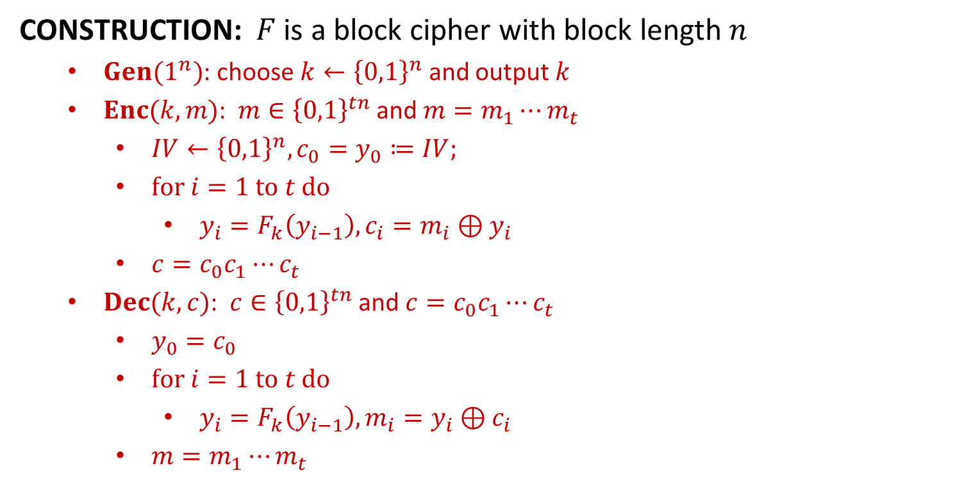











OFB
CONSTRUCTION: $F$ is a block cipher with block length $n$
$Gen(1^{n})$: choose $k←{\left\{0,1\right\}}^{n}$ and output $k$
$Enc(k,m)$: $m∈{\left\{0,1\right\}}^{tn}$ and $m=m_{1}⋯m_{t}$
$IV←{\left\{0,1\right\}}^{n}, {c_{0}=y}_{0}≔IV;$
$for i=1 to t do$
$y_{i}=F_{k}\left(y_{i−1}\right), c_{i}=m_{i}⊕y_{i}$
$c=c_{0}c_{1}⋯c_{t}$
$Dec(k,c)$: $c∈{\left\{0,1\right\}}^{tn}$ and $c=c_{0}c_{1}⋯c_{t}$
$y_{0}=c_{0}$
$for i=1 to t do$
$y_{i}=F_{k}\left(y_{i−1}\right), m_{i}=y_{i}⊕c_{i}$
$m=m_{1}⋯m_{t}$
$$IV$$
$$F_{k}$$
$$F_{k}$$
$$F_{k}$$
$$m_{1}$$
$$⨁$$
$$m_{2}$$
$$⨁$$
$$m_{3}$$
$$⨁$$
$$IV$$
$$c_{1}$$
$$c_{2}$$
$$c_{3}$$

Slide 3
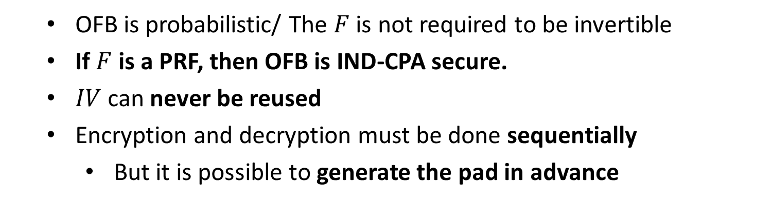
OFB
OFB is probabilistic/ The $F$ is not required to be invertible
If $F$ is a PRF, then OFB is IND-CPA secure.
$IV$ can never be reused
Encryption and decryption must be done sequentially
But it is possible to generate the pad in advance

Slide 4
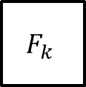




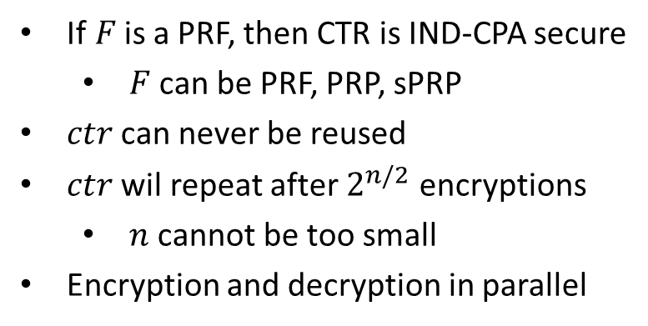



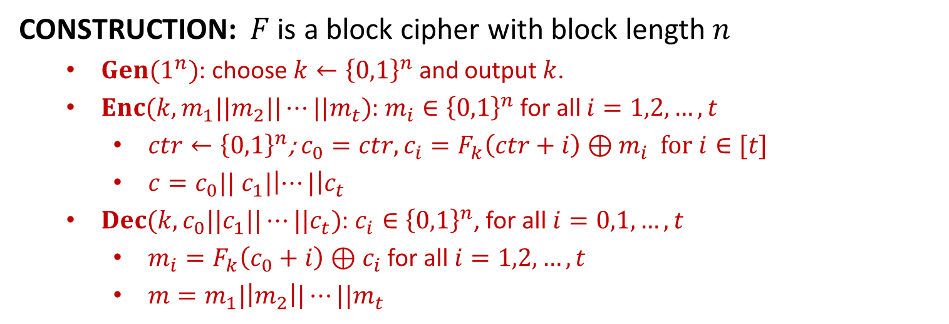








CTR
CONSTRUCTION: $F$ is a block cipher with block length $n$
$Gen(1^{n})$: choose $k←{\left\{0,1\right\}}^{n}$ and output $k$.
$Enc(k,m_{1}||m_{2}||⋯||m_{t})$: $m_{i}∈{\left\{0,1\right\}}^{n}$ for all $i=1,2,…,t$
$ctr←{\left\{0,1\right\}}^{n}$; $c_{0}=ctr, c_{i}=F_{k}\left(ctr+i\right)⊕m_{i}$ for $i∈[t]$
$c=c_{0}|| c_{1}|\left|⋯|\right|c_{t}$
$Dec(k,c_{0}||c_{1}||⋯||c_{t})$: $c_{i}∈{\left\{0,1\right\}}^{n}$, for all $i=0,1,…,t$
$m_{i}=F_{k}\left(c_{0}+i\right)⊕c_{i}$ for all $i=1,2,…,t$
$m=m_{1}|\left|m_{2}\right||⋯||m_{t}$
$$ctr$$
$$ctr+1$$
$$ctr+2$$
$$ctr+3$$
If$F$is a PRF, then CTR is IND-CPA secure
$F$ can be PRF, PRP, sPRP
$ctr$ can never be reused
$ctr$ wil repeat after $2^{n/2}$ encryptions
$n$ cannot be too small
Encryption and decryption in parallel
$$F_{k}$$
$$F_{k}$$
$$F_{k}$$
$$m_{1}$$
$$⨁$$
$$m_{2}$$
$$⨁$$
$$m_{3}$$
$$⨁$$
$$ctr$$
$$c_{1}$$
$$c_{2}$$
$$c_{3}$$

Slide 5
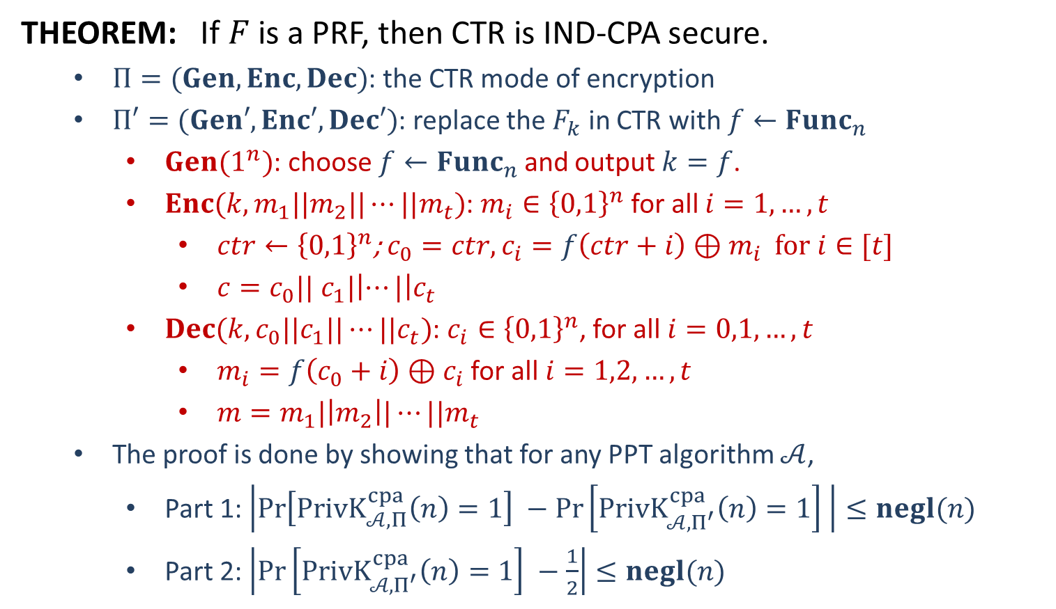
Security
THEOREM: If $F$ is a PRF, then CTR is IND-CPA secure.
$Π=(Gen,Enc,Dec)$: the CTR mode of encryption
$Π′=(Gen′,Enc′,Dec′)$: replace the $F_{k}$ in CTR with $f←Func_{n}$
$Gen(1^{n})$: choose $f←Func_{n}$ and output $k=f$.
$Enc(k,m_{1}||m_{2}||⋯||m_{t})$: $m_{i}∈{\left\{0,1\right\}}^{n}$ for all $i=1,…,t$
$ctr←{\left\{0,1\right\}}^{n}$; $c_{0}=ctr, c_{i}=f\left(ctr+i\right)⊕m_{i}$ for $i∈[t]$
$c=c_{0}|| c_{1}|\left|⋯|\right|c_{t}$
$Dec(k,c_{0}||c_{1}||⋯||c_{t})$: $c_{i}∈{\left\{0,1\right\}}^{n}$, for all $i=0,1,…,t$
$m_{i}=f\left(c_{0}+i\right)⊕c_{i}$ for all $i=1,2,…,t$
$m=m_{1}|\left|m_{2}\right||⋯||m_{t}$
The proof is done by showing that for any PPT algorithm $𝒜$,
Part 1: $\left|\operatorname{Pr}\left[PrivK_{𝒜, Π}^{cpa}\left(n\right)=1\right] −\operatorname{Pr}\left[PrivK_{𝒜, Π^{′}}^{cpa}\left(n\right)=1\right] \right|≤negl(n)$
Part 2: $\left|\operatorname{Pr}\left[PrivK_{𝒜, Π^{′}}^{cpa}\left(n\right)=1\right] −\frac{1}{2}\right|≤negl(n)$

Slide 6

























Part 1: $\left|\operatorname{Pr}\left[PrivK_{𝒜, Π}^{cpa}\left(n\right)=1\right] −\operatorname{Pr}\left[PrivK_{𝒜, Π^{′}}^{cpa}\left(n\right)=1\right] \right|≤negl(n)$
$$𝒪$$
$$𝒜$$
$${\left\{{ctr}_{i}+j\right\}}_{j=1}^{t_{i}}$$
$$x_{i}=\{x_{ij}:j∈\left[t_{i}\right]\}$$
$${ctr}_{i}←{\left\{0,1\right\}}^{n}$$
$$ctr_{i}$$
$$\{𝒪\left({ctr}_{i}+j\right)\}$$
$$\{𝒪\left({ctr}_{i}+j\right)⊕x_{ij}\}$$
$$m_{0},m_{1}$$
$${\left\{ctr+j\right\}}_{j=1}^{t}$$
$$ctr←{\left\{0,1\right\}}^{n}$$
$$\left|m_{0}\right|=|m_{1}|$$
$${\left\{𝒪\left(ctr+j\right)\right\}}_{j=1}^{t}$$
$$b←\{0,1\}$$
$$ctr$$
$$\{𝒪\left(ctr+j\right)⊕m_{bj}\}$$
$${\left\{{ctr}_{i}+j\right\}}_{j=1}^{t_{i}}$$
$$x_{i}$$
$${ctr}_{i}←{\left\{0,1\right\}}^{n}$$
$$ctr_{i}$$
$$\{𝒪\left({ctr}_{i}+j\right)\}$$
$$\{𝒪\left({ctr}_{i}+j\right)⊕x_{ij}\}$$
$$b^{′′}=\left\{\begin{aligned}0 b^{′}≠b \\ 1 b^{′}=b\end{aligned}\right.$$
$$b′$$
$$𝒟$$
$\left|\operatorname{Pr}\left[PrivK_{𝒜, Π}^{cpa}\left(n\right)=1\right] −\operatorname{Pr}\left[PrivK_{𝒜, Π^{′}}^{cpa}\left(n\right)=1\right] \right|=\left|\operatorname{Pr}\left[𝒟^{F_{k}}=1\right]−\operatorname{Pr}\left[𝒟^{f}=1\right]\right|$

Slide 7








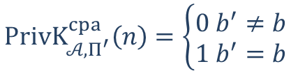











Part 2: $\left|\operatorname{Pr}\left[PrivK_{𝒜, Π^{′}}^{cpa}\left(n\right)=1\right] −\frac{1}{2}\right|≤negl(n)$
$$f←Func_{n}$$
$$𝒜$$
$$x_{i}=\{x_{ij}:j∈\left[t_{i}\right]\}$$
$${ctr}_{i}←{\left\{0,1\right\}}^{n}$$
$$ctr_{i}$$
$$\{f\left({ctr}_{i}+j\right)⊕x_{ij}\}$$
$$m_{0},m_{1}$$
$$ctr←{\left\{0,1\right\}}^{n}$$
$$\left|m_{0}\right|=|m_{1}|$$
$$b←\{0,1\}$$
$$challenger$$
$$ctr$$
$$\{f\left(ctr+j\right)⊕m_{bj}\}$$
$$x_{i}=\{x_{ij}:j∈\left[t_{i}\right]\}$$
$${ctr}_{i}←{\left\{0,1\right\}}^{n}$$
$$ctr_{i}$$
$$\{f\left({ctr}_{i}+j\right)⊕x_{ij}\}$$
$$PrivK_{𝒜, Π^{′}}^{cpa}\left(n\right)=\left\{\begin{aligned}0 b^{′}≠b \\ 1 b^{′}=b\end{aligned}\right.$$
$$b′$$
$q\left(n\right):$ upper bound of the message length&number of queries

Slide 8
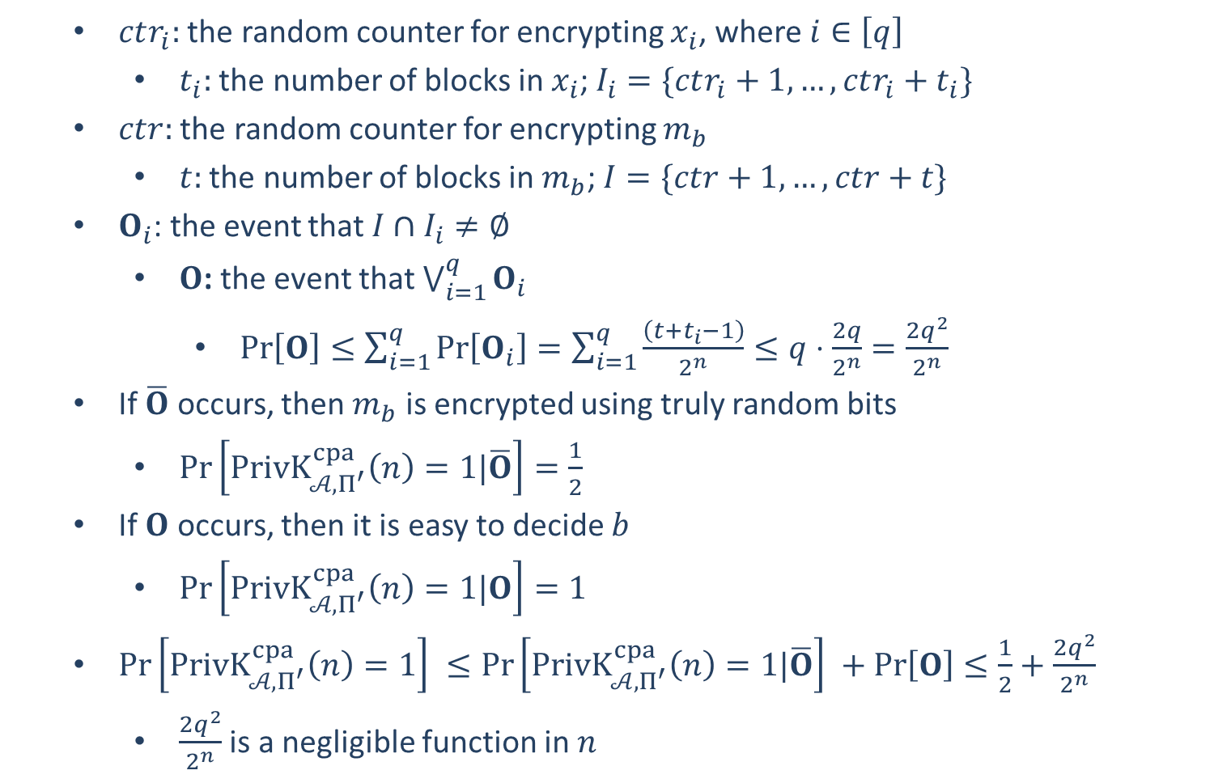
$ctr_{i}:$ the random counter for encrypting $x_{i}$, where $i∈\left[q\right]$
$t_{i}:$ the number of blocks in $x_{i}$; $I_{i}=\{ctr_{i}+1,…,ctr_{i}+t_{i}\}$
$ctr:$ the random counter for encrypting $m_{b}$
$t:$ the number of blocks in $m_{b}$; $I=\{ctr+1,…,ctr+t\}$
$O_{i}$: the event that $I∩I_{i}≠∅$
$O$: the event that $\bigvee_{i=1}^{q}{O_{i}}$
$\operatorname{Pr}\left[O\right]≤\sum_{i=1}^{q}{\operatorname{Pr}\left[O_{i}\right]}=\sum_{i=1}^{q}{\frac{\left(t+t_{i}−1\right)}{2^{n}}}≤q⋅\frac{2q}{2^{n}}=\frac{2q^{2}}{2^{n}}$
If $\overline{O}$ occurs, then $m_{b}$ is encrypted using truly random bits
$\operatorname{Pr}\left[PrivK_{𝒜, Π^{′}}^{cpa}\left(n\right)=1|\overline{O}\right]=\frac{1}{2}$
If $O$ occurs, then it is easy to decide $b$
$\operatorname{Pr}\left[PrivK_{𝒜, Π^{′}}^{cpa}\left(n\right)=1|O\right]=1$
$\operatorname{Pr}\left[PrivK_{𝒜, Π^{′}}^{cpa}\left(n\right)=1\right] ≤\operatorname{Pr}\left[PrivK_{𝒜, Π^{′}}^{cpa}\left(n\right)=1|\overline{O}\right] +\operatorname{Pr}\left[O\right]≤\frac{1}{2}+\frac{2q^{2}}{2^{n}}$
$\frac{2q^{2}}{2^{n}}$ is a negligible function in $n$

Slide 10


Message Integrity
Transfer $1000 from Alice’s account to Bob’s
$$Alice$$
Questions that will be asked by the bank:
Is the message really from Alice?
Has the message been modified?
Message Integrity: prevent undetected tampering of messages
Unauthorized modifications should be detectable
Encryptions cannot provide message integrity:
Encryption can prevent unauthorized access of the messages
Encryption cannot prevent undetected tampering of messages

